Slide 1

Mlem Mlem
Project Ideas
Team Four
© 2021 - Team Four - FPT University

Slide 2
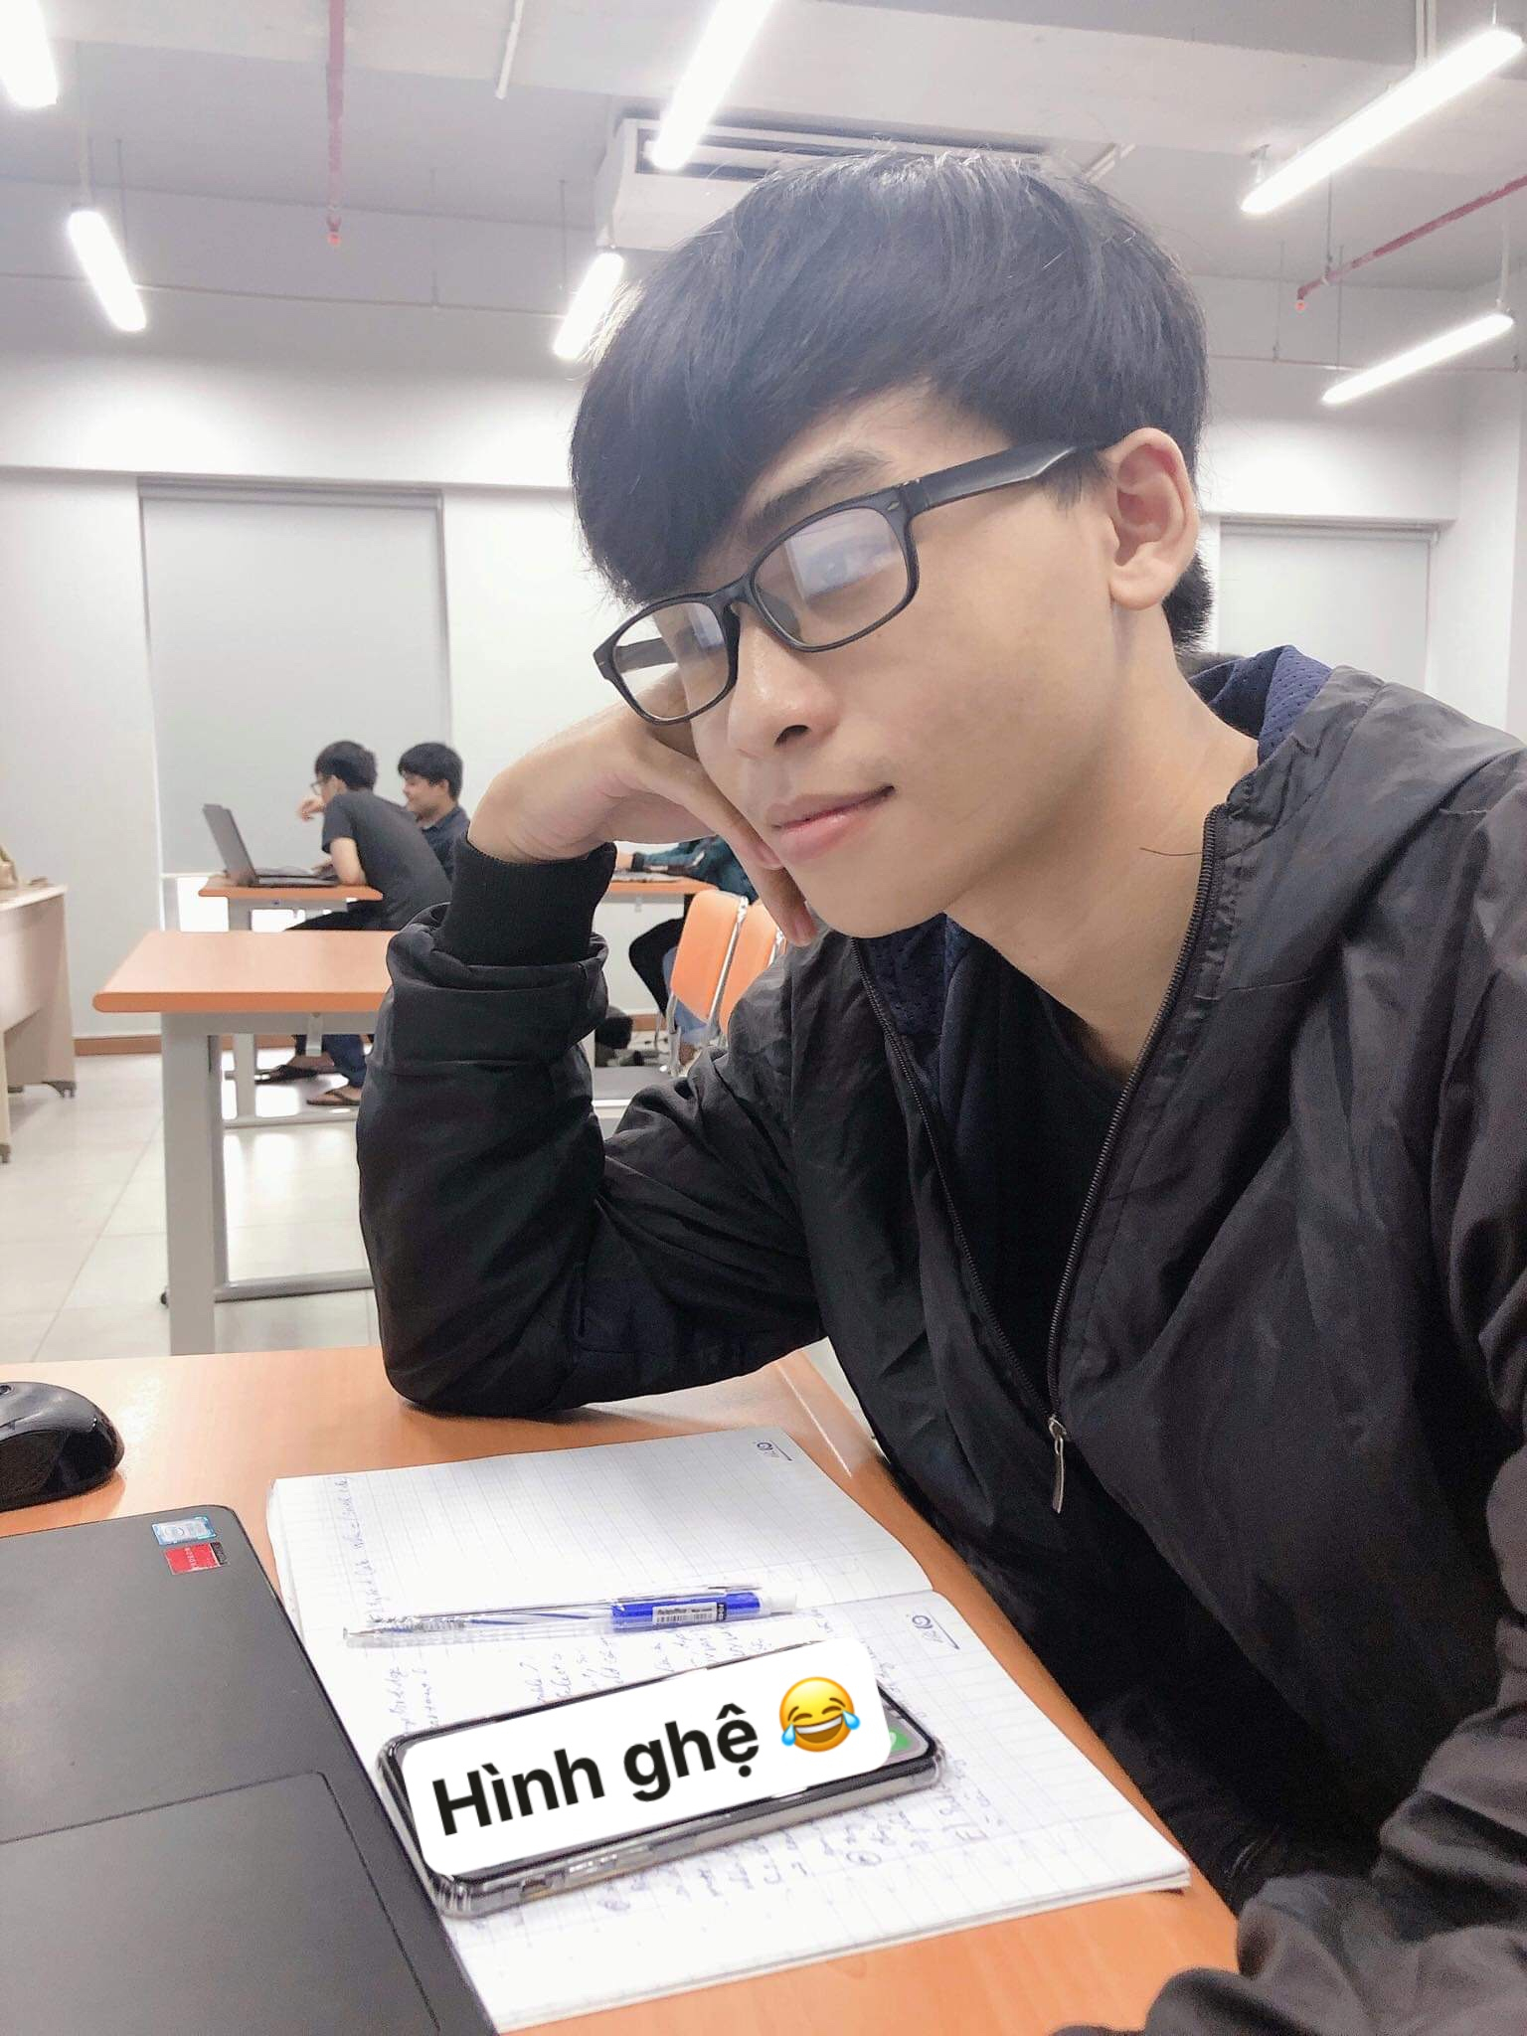
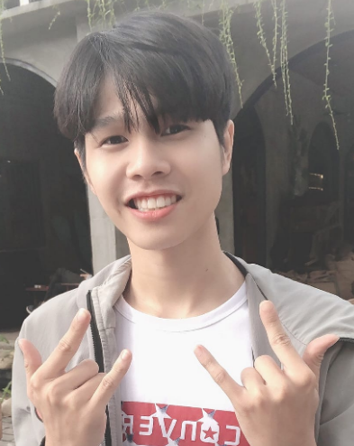
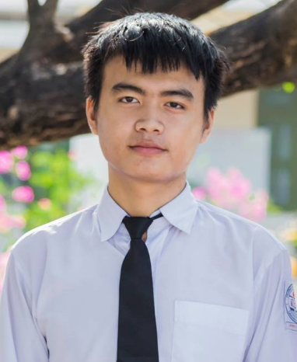
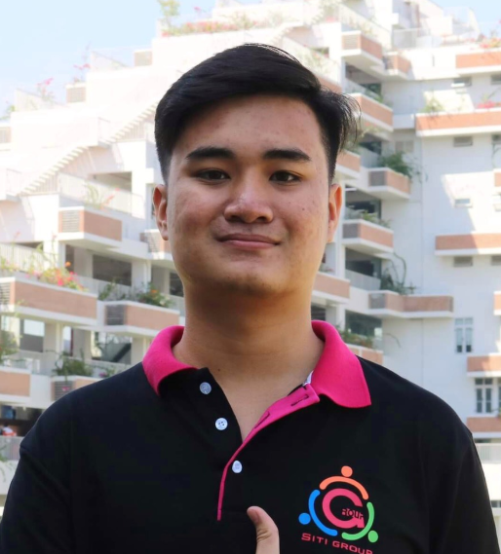
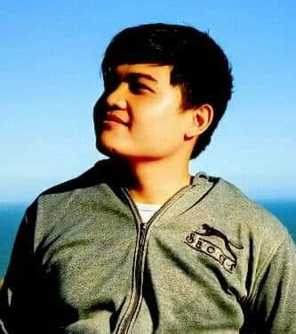
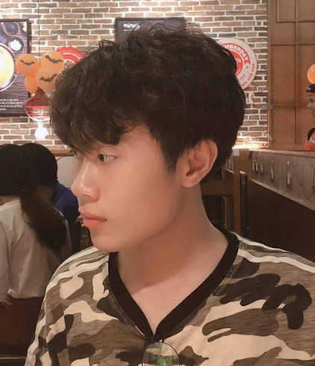
Diệp Quốc Lộc
Bành Đức Hiếu
Tel: 0344087348
Email: locdqse141081@fpt.edu.vn
Fb: facebook.com/id=100008306497290
Tel: 0908019700
Email: hieubdse140896@fpt.edu.vn
Fb: facebook.com/Kiriduchieu.S/
Phạm Mạnh Toàn
Võ Minh Tiến
Team Four
Tel: 0363964364
Email: toanmpse140895@fpt.edu.vn
Fb: facebook.com/id=100009257124188
Tel: 0346754957
Email: tienvmse140881@fpt.edu.vn
Fb: facebook.com/tienFuK14/
Huỳnh Ngọc Linh
Nguyễn Minh Long
Tel: 0822878279
Email: linhhnse140845@fpt.edu.vn
Fb: facebook.com/lang.nhin.92123/
Tel: 0326443600
Email: longnmse140892@fpt.vn.edu
Fb: facebook.com/long.lo.50596/
© 2021 - Team Four - FPT University

Slide 3
Agenda
Background.
Operational Concepts (What is it? Main Features)
Basic Layouts
Lifecycle Plan
Conclusion
© 2021 - Team Four - FPT University

Slide 4
01
Background
© 2021 - Team Four - FPT University

Slide 5





Background
01
© 2021 - Team Four - FPT University

Slide 6
01
Background
11.5%
14.3%
88.5%
- Phí ship: 15.000đ ~ 100.000đ.
- 85.7% người dùng muốn giảm phí ship.
- Nhóm ship: 3 ~ 5 người.
85.7%
© 2021 - Team Four - FPT University

Slide 7
02
Operational Concepts (What is it?/Main feature)
© 2021 - Team Four - FPT University

Slide 8


02
Operational Concepts (What is it?/Main feature)
Cá nhân
Food & Drinks
Share Ship
© 2021 - Team Four - FPT University

Slide 9
03
Basic Layouts
© 2021 - Team Four - FPT University

Slide 10
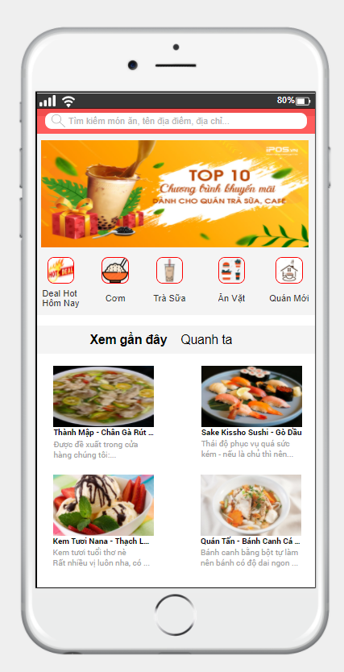
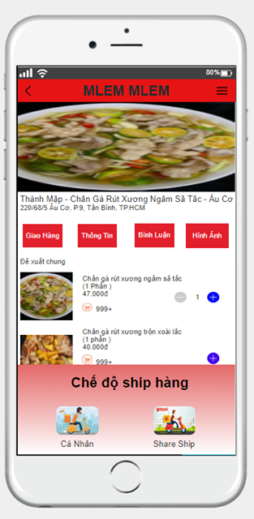
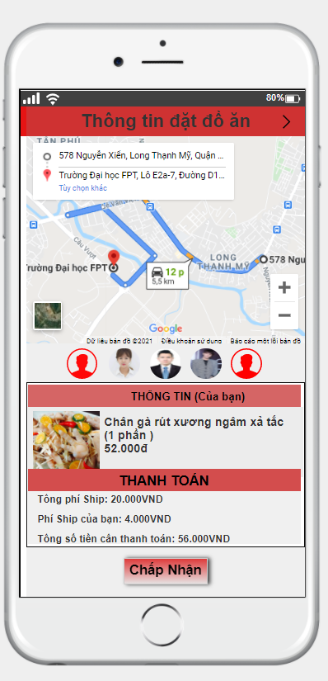
03
Basic Layouts
© 2021 - Team Four - FPT University

Slide 11
04
Lifecycle Plan
© 2021 - Team Four - FPT University

Slide 12
04
Lifecycle Plan
Solution Discussion 19/01/2021 - . . .
Background Study 08/01/2021 - 18/01/2021
Kick-off meeting 07/01/2021
© 2021 - Team Four - FPT University

Slide 13


04
Lifecycle Plan
Sử dụng các nền tảng mạng xã hội để quảng cáo ứng dụng ra thị trường
© 2021 - Team Four - FPT University

Slide 14
05
Conclusion
© 2021 - Team Four - FPT University

Slide 15
05
Conclusion
Mục đích:
- Giảm phí ship.
- Tạo sự chủ động cho người dùng.
- Giảm rủi ro bùng hàng, phí ship.
Mục tiêu:
- Cải thiện, thêm mới các tính năng của ứng dụng.
- Đưa ứng dụng đến với đông đảo người dùng.
Cá nhân
Food & Drinks
Share Ship
© 2021 - Team Four - FPT University

Slide 16
References
- Slide template: https://www.slidescarnival.com/
- Use JustInMind to design prototype.
- Use Google Form to market servey.
- Use Google Meet to meeting.
© 2021 - Team Four - FPT University

Slide 17

Thank you
© 2021 - Team Four - FPT University

Slide 18
© 2021 - Team Four - FPT University

